Slide 1
Topic: Isometric drawings
EQ: How do I use isometric paper to draw solids?
Get your VIVOS
Get diary out and write in mathspace homework
New topic so new unit cover page and note this in the contents page
Collect test paper
Collect isometric paper
Collect 5 blocks

Slide 2
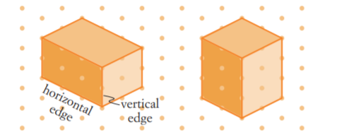
24
7
30
Topic: Isometric drawings
Date
EQ: How do I use isometric paper to draw solids?
What is isometric paper?
Solids can be difficult to draw. Sometimes it is easier to use square dot paper or isometric dot paper to draw them.
The rectangular prisms shown below are drawn on isometric dot paper, with the dots arranged in a triangular pattern.
Horizontal edges are drawn at a slant on this paper.
A 2D (flat) diagram of a 3D figure (solid) looks more natural when drawn on isometric paper.

Slide 3
24
7
30
Topic: Isometric drawings
Date
EQ: How do I use isometric paper to draw solids?
How to draw on isometric paper?
https://www.youtube.com/watch?v=Bvc_gYHlgJs

Slide 4
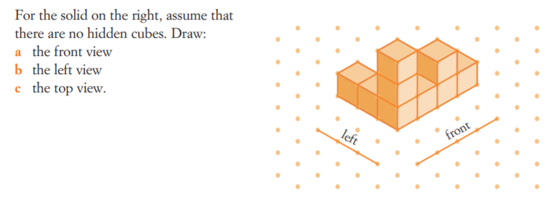
24
7
30
Topic: Isometric drawings
Date
EQ: How do I use isometric paper to draw solids?
Example 1:

Slide 5
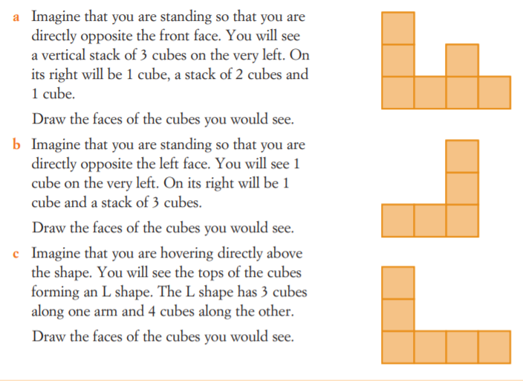
24
7
30
Topic: Isometric drawings
Date
EQ: How do I use isometric paper to draw solids?
Answer:

Slide 6
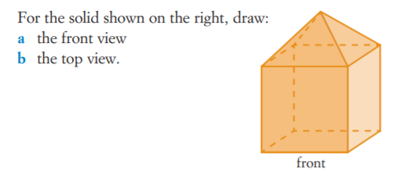
24
7
30
Topic: Isometric drawings
Date
EQ: How do I use isometric paper to draw solids?
Example 2:

Slide 7
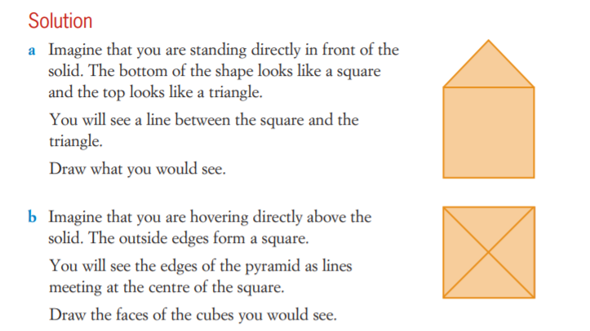
24
7
30
Topic: Isometric drawings
Date
EQ: How do I use isometric paper to draw solids?
Answer:

Slide 8
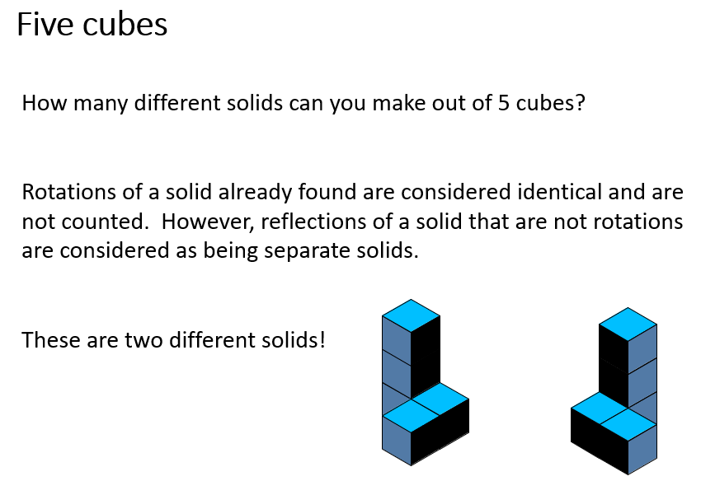
24
7
30
Topic: Isometric drawings
Date
EQ: How do I use isometric paper to draw solids?
Practice:

Slide 9
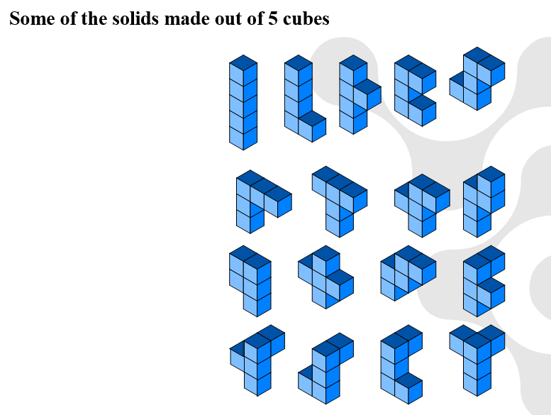
24
7
30
Topic: Isometric drawings
Date
EQ: How do I use isometric paper to draw solids?
Answer:

Slide 10
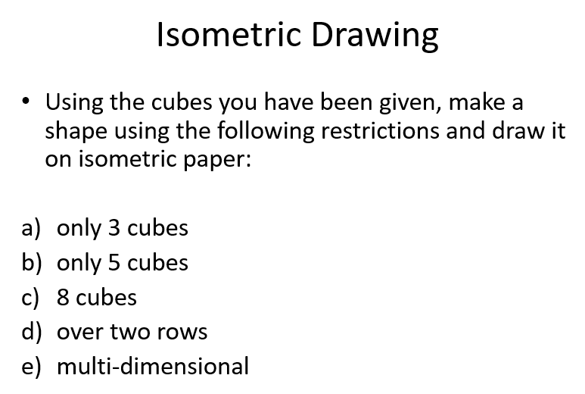
24
7
30
Topic: Isometric drawings
Date
EQ: How do I use isometric paper to draw solids?
Practice:

Slide 11
